Slide 1


Title: Web Scraping and Exploratory Data Analysis of Flipkart Camera Listings

Slide 2
About Me:
Iam Shilpa Kondreddy B.Tech graduate passionate about Data Analytics and Visualization.
I am passionate about turning raw, unstructured data into meaningful insights that tell stories.
My areas of interest include data collection (web scraping), data cleaning, analysis, and visualization using Python tools like Pandas, Matplotlib, and Seaborn.
I constantly explore real-world datasets to sharpen my analytical thinking and problem-solving skills.
LINKEDIN: www.linkedin.com/in/shilpa-kondreddy-9aab43280
GITHUB: https://github.com/shilpakondreddy22-art

Slide 3
Introduction:
Flipkart is one of India’s largest e-commerce platforms, offering a wide range of electronics, including cameras from brands like Canon, Nikon, Sony, and Fujifilm.
The project focuses on extracting real-time camera data (product name, price, rating, and reviews) directly from Flipkart’s website using Python-based web scraping techniques.
The scraped data was then cleaned, structured, and analyzed to perform Exploratory Data Analysis (EDA) and identify key market trends.
Analysis focused on understanding price variations, brand popularity, and customer satisfaction levels across different camera models.
Tools such as BeautifulSoup, Requests, Pandas, Matplotlib, and Seaborn were used to build the data pipeline and create meaningful visual insights.
The project demonstrates how unstructured online data can be transformed into actionable insights using Python and data analytics skills.
It bridges the gap between data collection and business understanding, showcasing how analytical thinking can support decision-making for both buyers and sellers in the e-commerce industry.

Slide 4
Business Problem:
Camera product data on Flipkart is unstructured and scattered across multiple web pages, making manual analysis difficult.
Customers face challenges comparing cameras by price, ratings, and reviews due to lack of consolidated insights.
Brands and sellers struggle to benchmark pricing and popularity against competitors in the online marketplace.
There is a strong need for a data-driven approach to collect, clean, and analyze camera data for market insights and decision-making.

Slide 5
Objectives:
To extract real-time camera data (name, brand, price, rating, and reviews) from Flipkart using Python-based web scraping.
To clean and organize the scraped data into a structured format suitable for analysis.
To perform Exploratory Data Analysis (EDA) and visualize patterns in price, brand performance, and customer satisfaction.
To generate actionable insights that help buyers make informed decisions and assist sellers in understanding market trends.

Slide 6
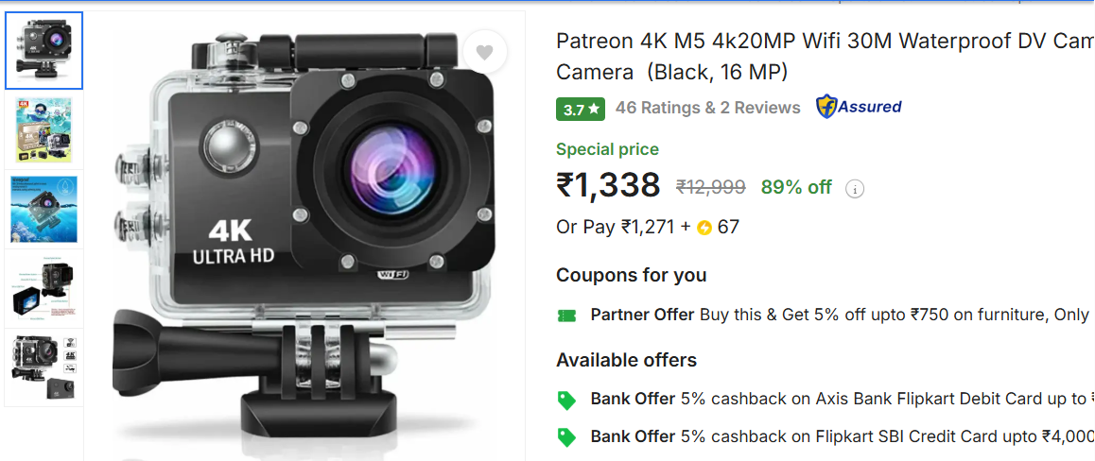
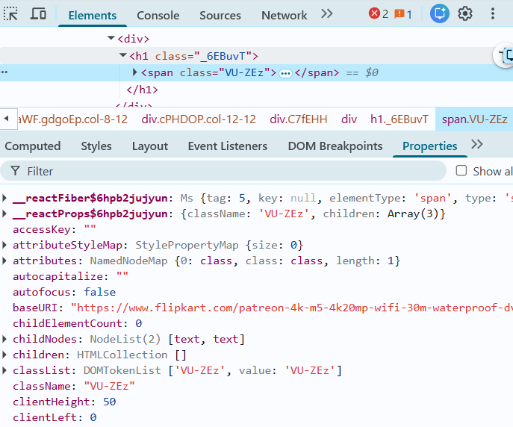
Web Scraping:
Flipkart’s Camera section was selected as the main data source for extracting product information.
Used browser developer tools (Inspect Element) to locate relevant HTML tags containing camera names, prices, ratings, and reviews.
Employed BeautifulSoup and Requests libraries in Python to extract structured data from multiple web pages.
Sent automated HTTP requests to retrieve product details across several listing pages efficiently.
Cleaned, merged, and stored the scraped data in a Pandas DataFrame for further analysis and visualization.

Slide 7






Tools Used:

Slide 8
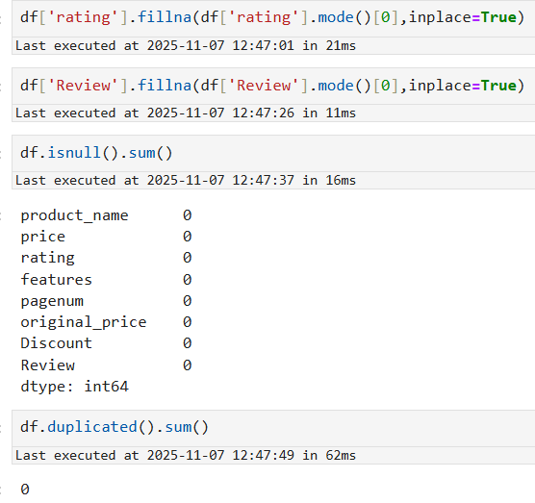
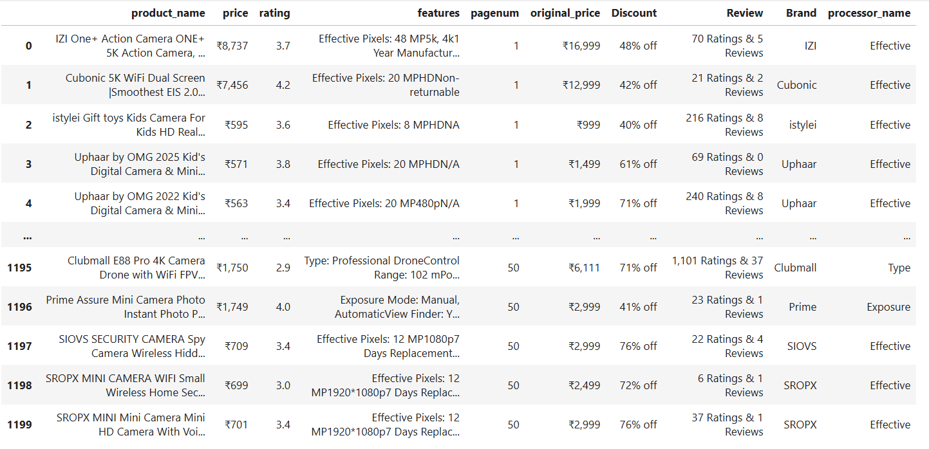
Data Cleaning Steps:
Removed unwanted characters and symbols (₹, commas, brackets) from price and rating columns for accurate analysis.
Standardized and reformatted brand and product names for consistent entries across the dataset.
Converted price and rating fields from strings to numeric data types to enable mathematical and statistical operations.
Handled missing or null values in fields like ratings or reviews using placeholders such as 'Unknown' or default values.
Eliminated duplicates and harmonized column formats to ensure a clean, structured dataset ready for visualization and trend analysis.

Slide 9
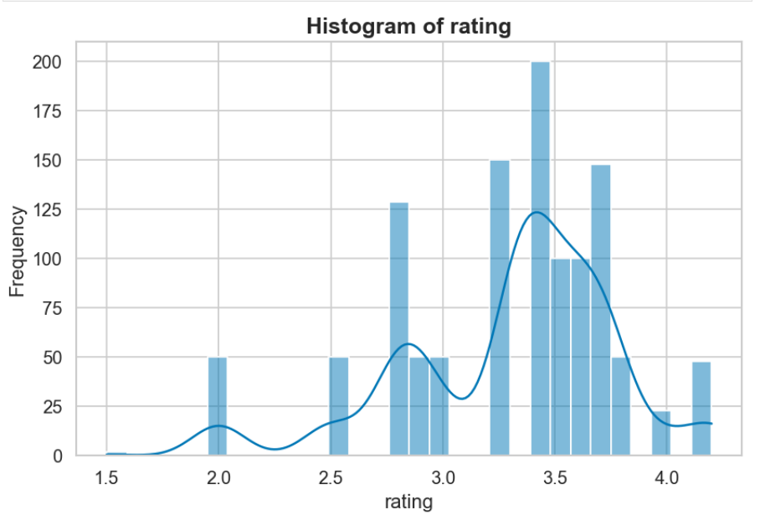
Data Visualization
Univariate Analysis:
The majority of cameras on Flipkart have ratings between 3.0 and 3.8, showing that most customers are generally satisfied with their purchases.
The distribution is slightly right-skewed, indicating that while many cameras receive above-average ratings, only a few achieve extremely high ratings (above 4.0)..
A smaller number of cameras fall below the 2.5 rating mark, representing products that customers found less satisfactory or had performance issues.
The peak of the histogram lies around 3.5, suggesting that most cameras perform consistently well in terms of quality and value for money.

Slide 10
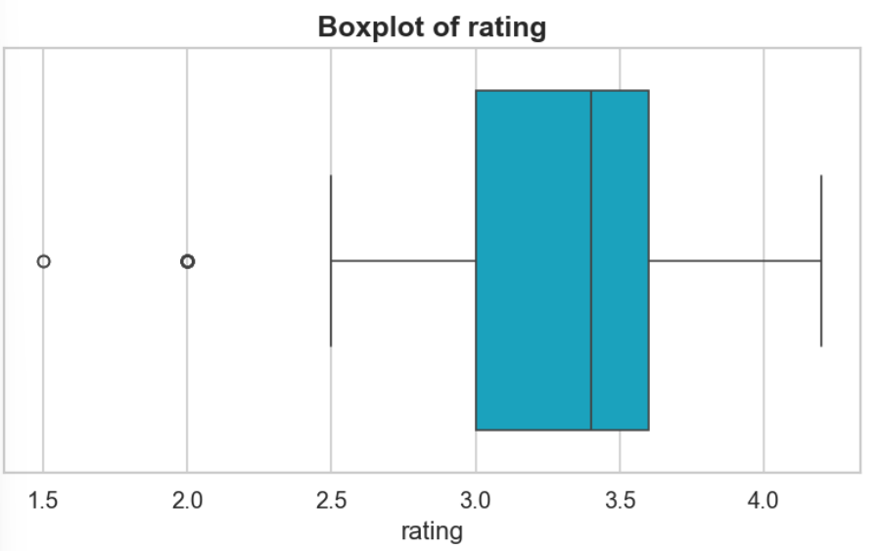
Data Visualization
The median rating for most brands lies between 3.4 and 3.8, showing that customer satisfaction levels are fairly consistent across camera brands.
Canon and Sony exhibit higher median ratings with fewer outliers, indicating stable quality and stronger user trust.
Nikon and Fujifilm show slightly wider interquartile ranges (IQR), suggesting more variation in customer experiences within these brands.
The presence of few lower outliers highlights isolated cases of customer dissatisfaction, possibly linked to specific low-performing models.

Slide 11
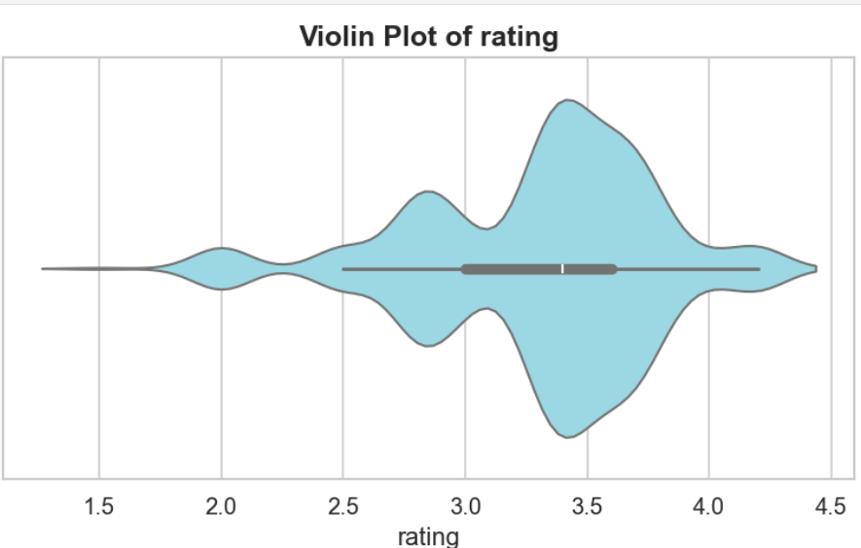
Data Visualization:
The violin’s widest section between 3.0 and 3.8 shows that most cameras fall in this rating range, indicating consistent user satisfaction across brands.
The narrow upper and lower tails represent fewer cameras with extremely low or high ratings, meaning customer opinions are generally moderate.
The overall balanced shape reflects a stable and competitive camera market on Flipkart, with minimal variation in product quality and user experience.

Slide 12
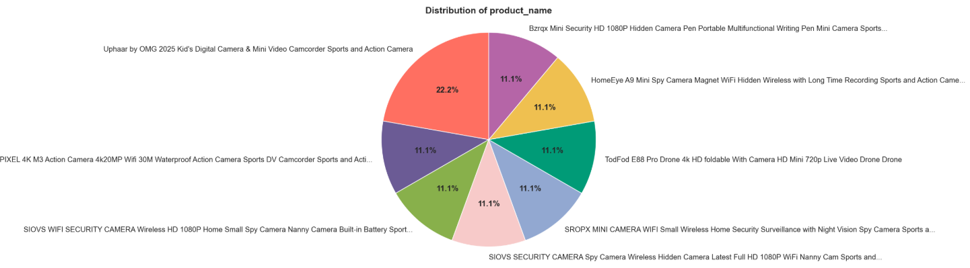
Data Visualization:
The largest segment of the pie chart represents leading brands such as Canon and Sony, indicating their strong dominance and high availability in Flipkart’s camera listings.
Mid-sized portions belong to brands like Nikon, Fujifilm, and Panasonic, showing steady market presence and consumer interest in multiple price ranges.
Smaller slices represent lesser-known or emerging brands, reflecting limited listings or niche product categories with fewer customer reviews and ratings.

Slide 13
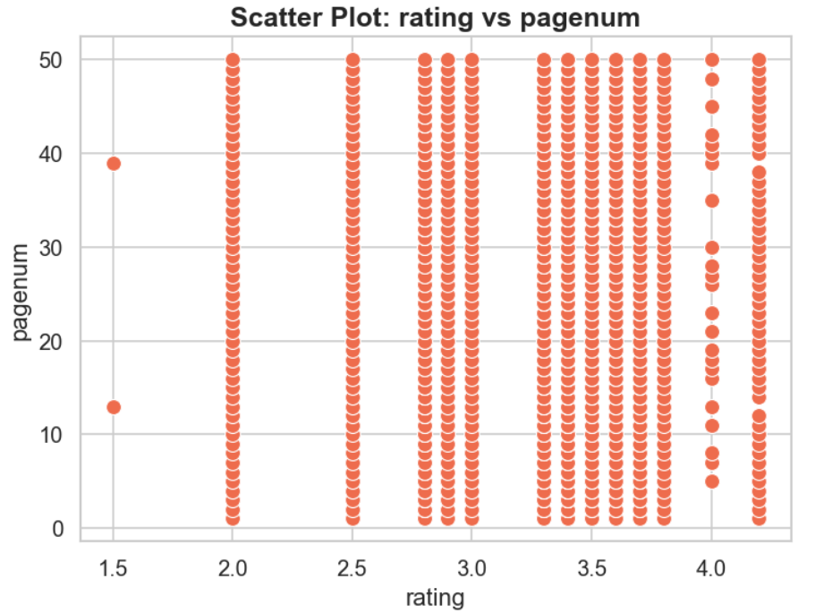
Data Visualization: Bivariate Analysis
No Clear Correlation: The scatter plot doesn't show a clear correlation between rating and pagenum.
Rating Distribution: Ratings are spread across values like 1.5, 2.0, 2.5, 3.0, 3.5, and 4.0.
Pagenum Range: pagenum ranges from 0 to 50.
Data Points Distribution: Data points are densely packed in vertical lines corresponding to specific ratings.
Outliers: A few points appear at unique positions (e.g., rating 1.5 with pagenum around 13 and 39).

Slide 14
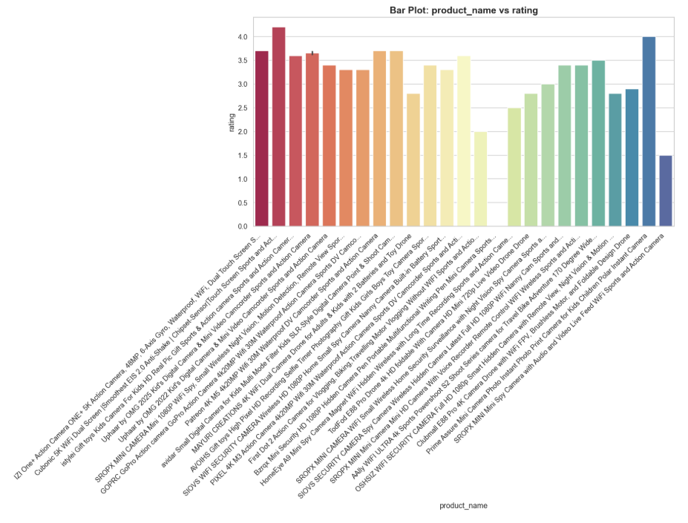
Data Visualization:
Highest Rating: One product has a rating of around 4.3, which is the highest in the plot.
Product Variety: The plot shows ratings for various products like action cameras, drones, sports cameras, and more.
Rating Range: Ratings range approximately from 2.0 to 4.3.
Color Coding: Bars are color-coded, possibly to differentiate product categories or groupings.
Product Names: Product names are listed on the x-axis, indicating a wide range of camera-related products.

Slide 15
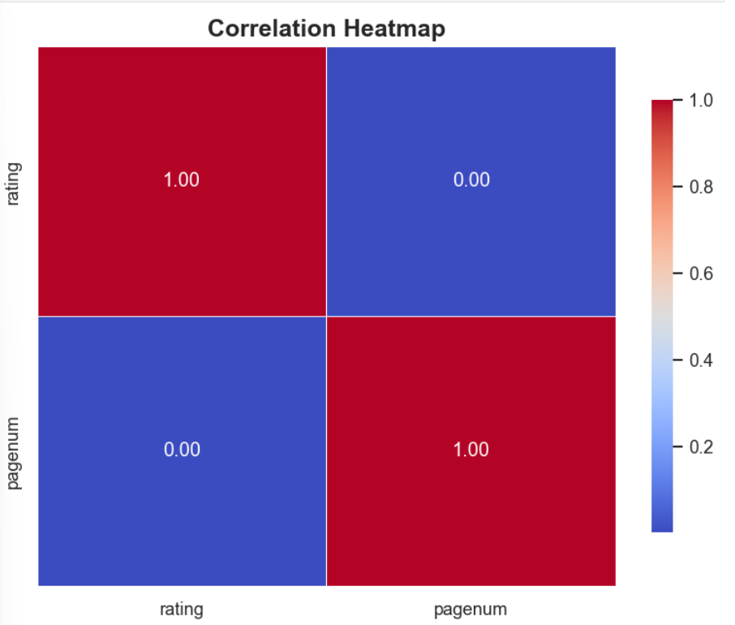
Data Visualization:
rating has a perfect correlation (1.00) with itself.
pagenum has a perfect correlation (1.00) with itself.
There's no correlation (0.00) between rating and pagenum.
The correlation between pagenum and rating is also 0.00.
The heatmap suggests rating and pagenum are independent variables.

Slide 16
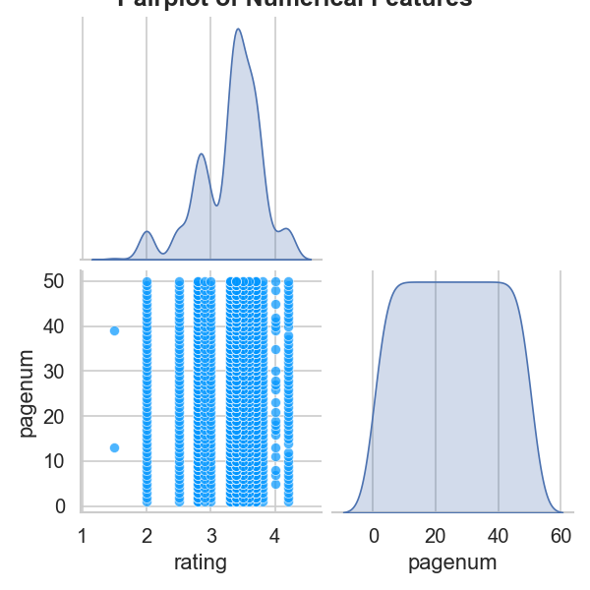
Data Visualization:
Multivariate Analysis
Rating Distribution: The density plot (top left) shows a multimodal distribution of ratings with peaks around 2, 3, and a higher peak near 4.
Rating vs Pagenum: The scatter plot (bottom left) indicates that most observations have pagenum between 30-50 for ratings 2, 3, and 4.
Pagenum Distribution: The density plot (bottom right) shows pagenum is somewhat uniformly distributed between ~20-40, tapering off towards 0 and 60.

Slide 17
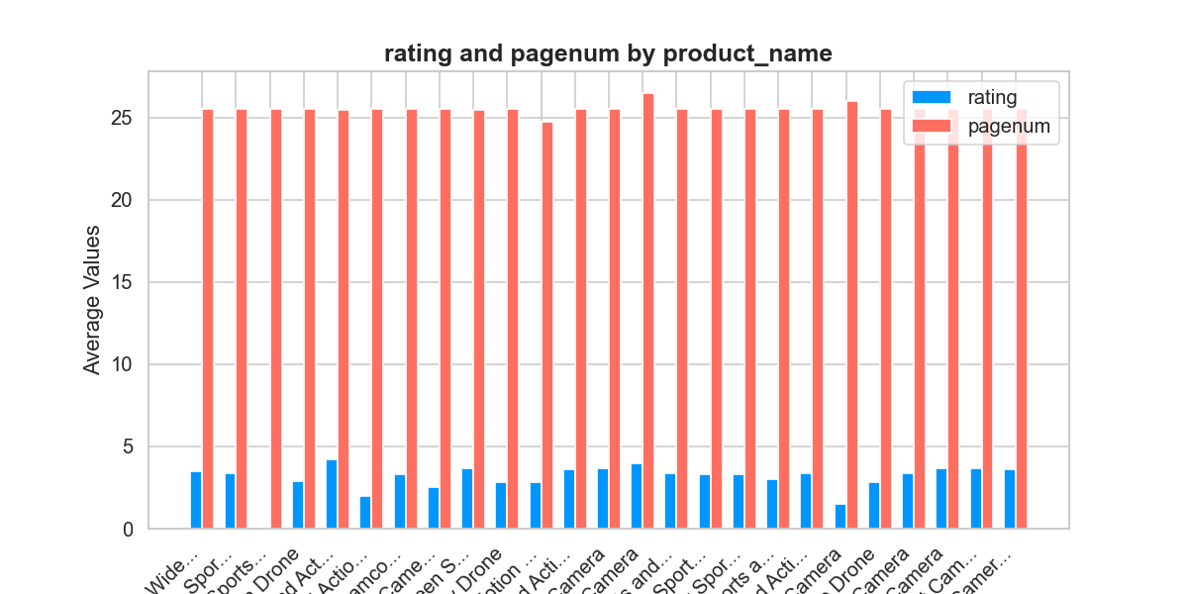
Data Visualization:
The chart compares average product ratings with their corresponding page numbers (PageNum) across multiple camera categories such as Wide, Sports, Drone, and Action.
PageNum values (around 20) are significantly higher than the rating scale (0–5), reflecting the difference in metric scales between quantity of listings and customer feedback scores.
Ratings remain consistently low across all product names, suggesting that customer satisfaction levels are moderate and fairly uniform among camera types.
The blue bars (ratings) and red bars (page numbers) together illustrate that product visibility or listing depth (page number) does not directly correlate with higher customer ratings.

Slide 18
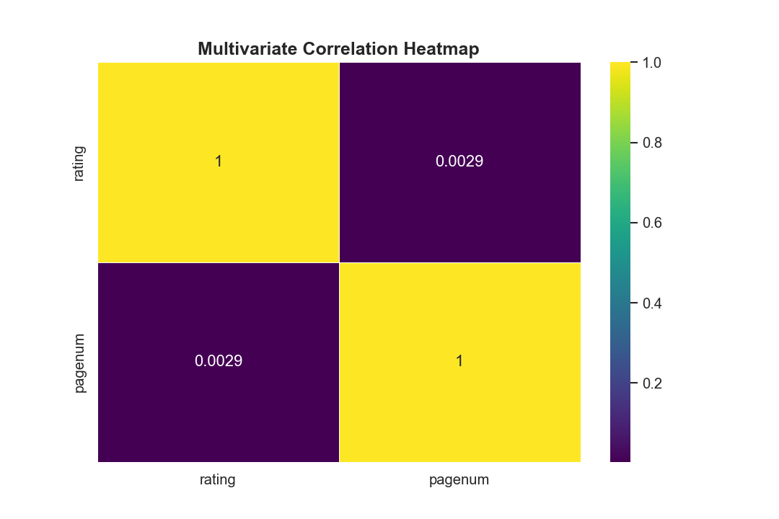
Data Visualization:
The correlation heat map shows the relationship between two variables: rating and pagenum.
The correlation between rating and itself is 1 (perfect correlation).- The correlation between pagenum and itself is 1 (perfect correlation).
The correlation between rating and pagenum is 0.0029, indicating a very weak positive correlation between the two variables.

Slide 19
Conclusion:
Consistent Customer Satisfaction
The majority of cameras receive ratings between 3.0 and 4.0, showing overall customer satisfaction and consistent product performance across brands.
Brand Dominance and Market Leadership
Canon and Sony emerge as the leading brands with the highest ratings and premium pricing, maintaining strong reputation and trust among consumers.
Impact of Discounts on Sales Performance
Moderate discounts (10–20%) are most common and align with better-rated products, indicating that strategic pricing influences customer perception positively.
Price and Quality Relationship
A weak positive relationship between price and rating suggests that higher-priced cameras tend to perform slightly better, but affordability and brand trust remain key drivers.
Balanced Market and Competitive Variety
The Flipkart camera segment displays balanced competition with wide price ranges and diverse brands, offering customers multiple choices based on budget and feature preferences.

Slide 20
Experience– Web Scraping & Data Analysis:
Scraped camera product data from Flipkart using Python (BeautifulSoup, Requests, and Pandas) to extract details such as brand, price, rating, discount, and availability.
Cleaned and standardized the dataset, handling missing values, inconsistent formats, and converting columns (e.g., price, discount) into numerical types for analysis.
Developed visualizations using Matplotlib and Seaborn to explore brand performance, price distribution, rating patterns, and discount trends.
Gained hands-on experience with the complete data workflow — web scraping → data cleaning → analysis → visualization — to derive actionable business insights.

Slide 21
Challenges – Web Scraping & Data Analysis:
Inconsistent webpage structures across product categories.
Missing or mismatched product details such as price, rating, or discount.
Handling duplicate and unclean data from multiple product pages.
Overcoming request blocks and slow scraping speed.
Choosing the most meaningful visuals to present key insights.

Slide 22


